Slide 1



An evidence synthesis of the environmental PPCP literature:
Imbalances in compounds, sewage treatment techniques,
and ecosystem types
Michael F. Meyer (michael.f.meyer@wsu.edu)
Stephen M. Powers
Stephanie E. Hampton
@mishafredmeyer
@st3powers
@se_hampton

Slide 2
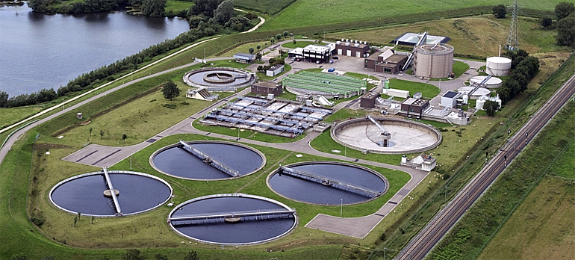
Interdisciplinary Research Effort
https://www.dutchlandinc.com/blog/2019/01/wastewater-treatment-plants-work-comprehensive-look-part-2/

Slide 3
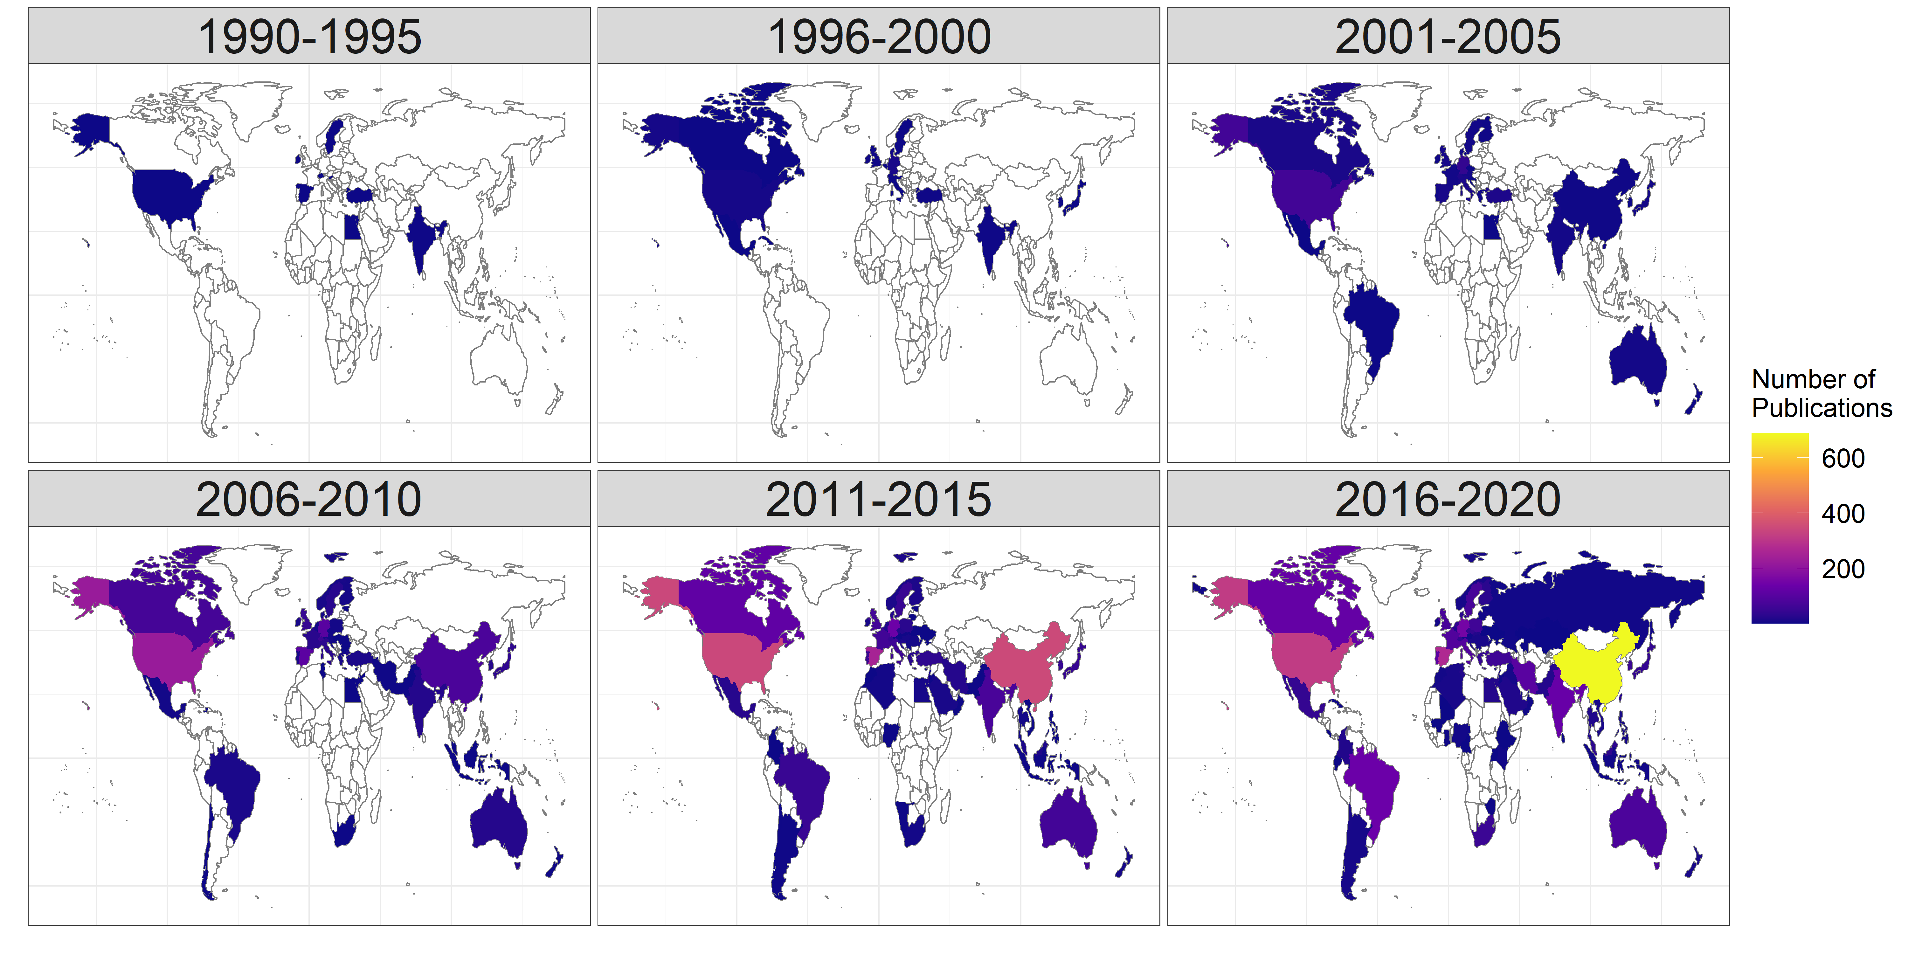
Global Research Effort

Slide 4


But are we seeing the whole picture?
xkcd.com

Slide 5


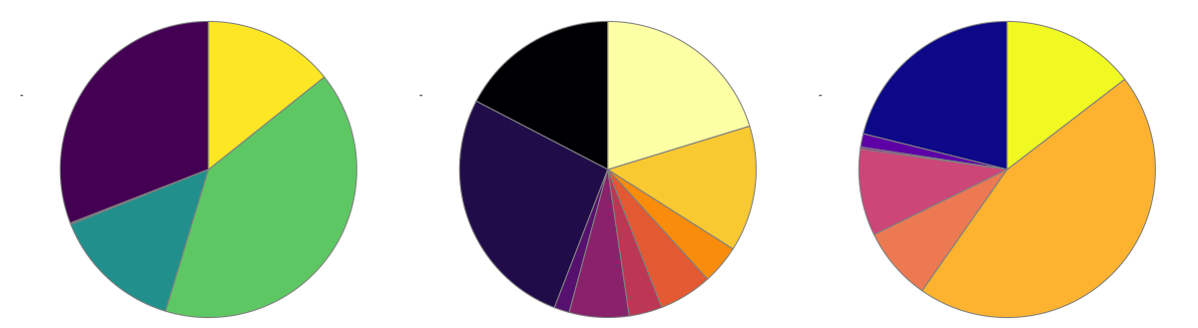
Tracking the literature
Web of Science search “TS = pharmaceutical* AND TS = (‘sewage’ OR ‘wastewater’)”
with refinement for environmental subject categories
Search abstracts for 70 focal PPCPs
Search abstracts for 15 focal Sewage Treatment Techniques (STTs)
Search abstracts for 12 focal ecosystem types

Slide 6



For a more nuanced look…
For updated R code, follow this QR code
to my GitHub repository!

Slide 7
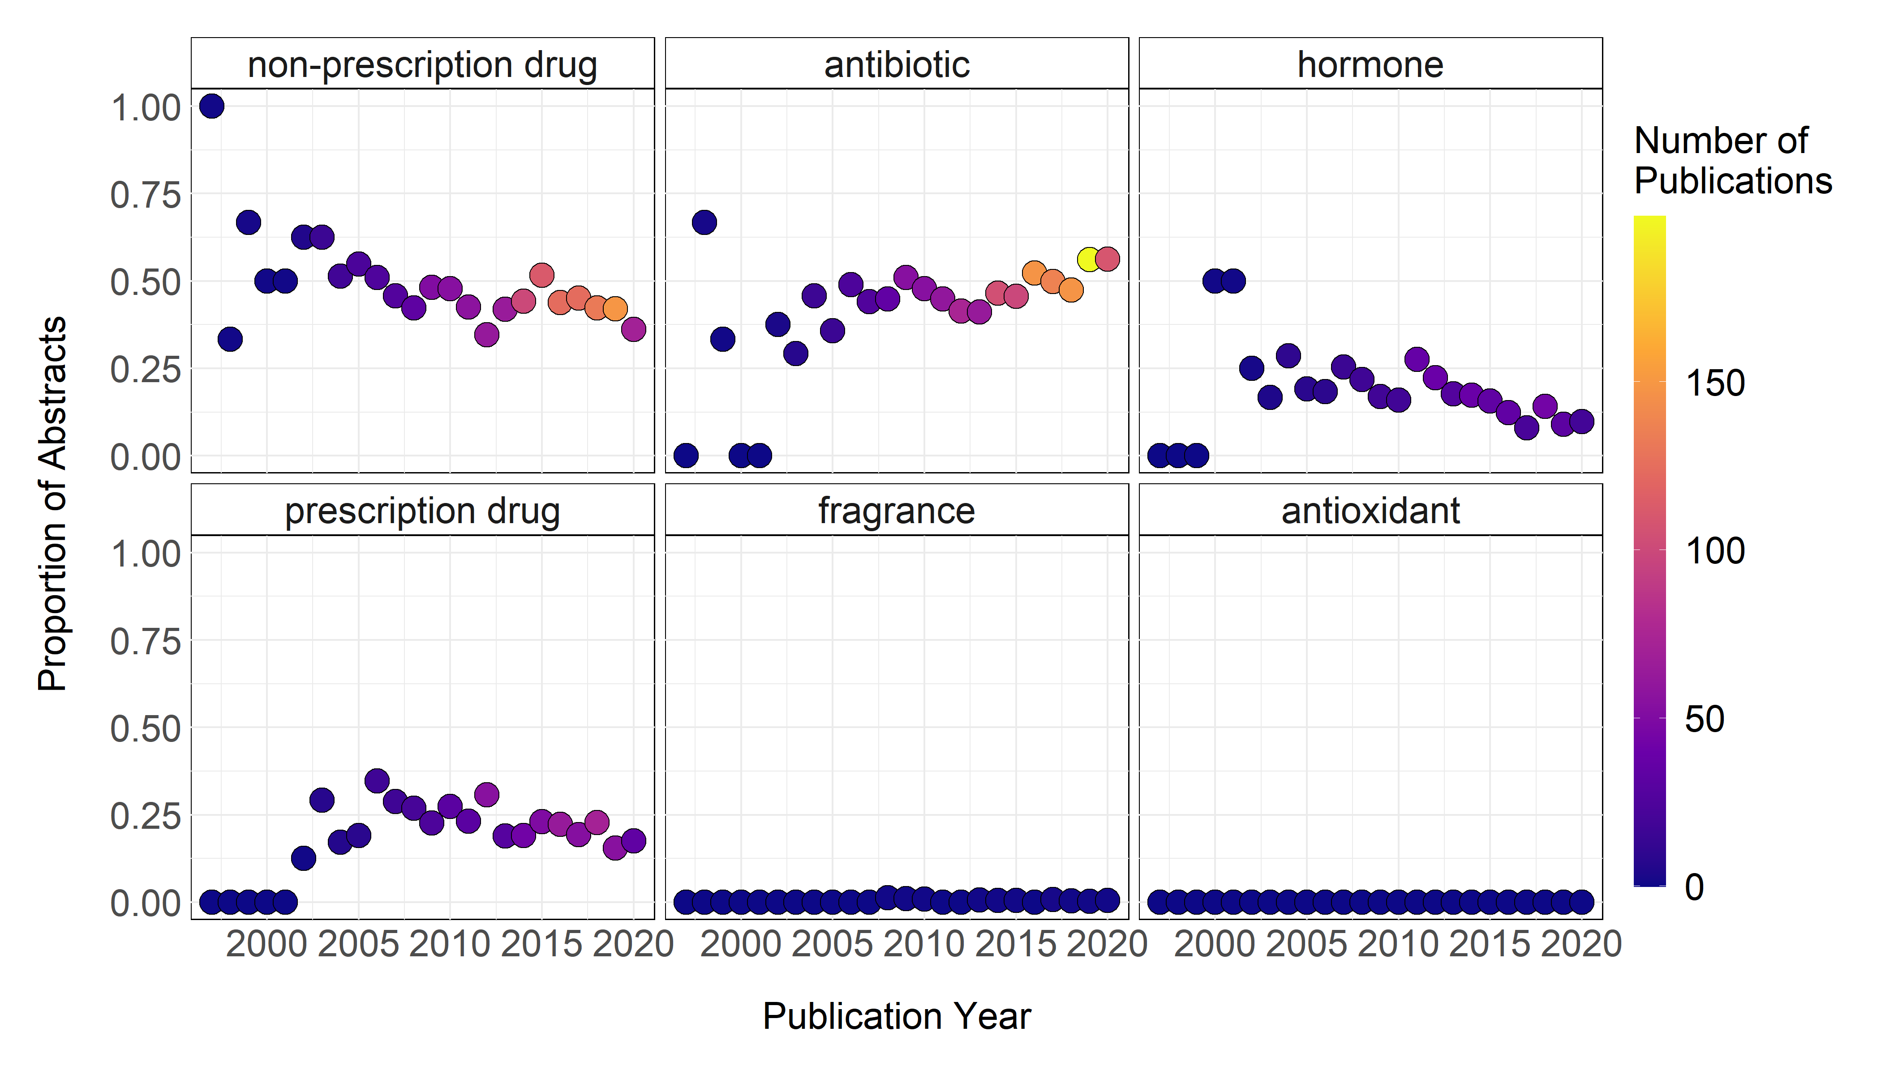
Most studied PPCPs?

Slide 8
Less well studied PPCPs?

Slide 9
Least studied PPCPs?

Slide 10
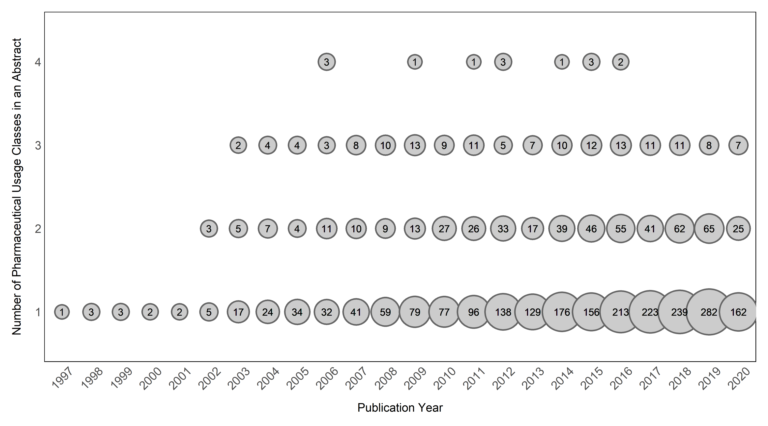
Number of PPCPs per study

Slide 11
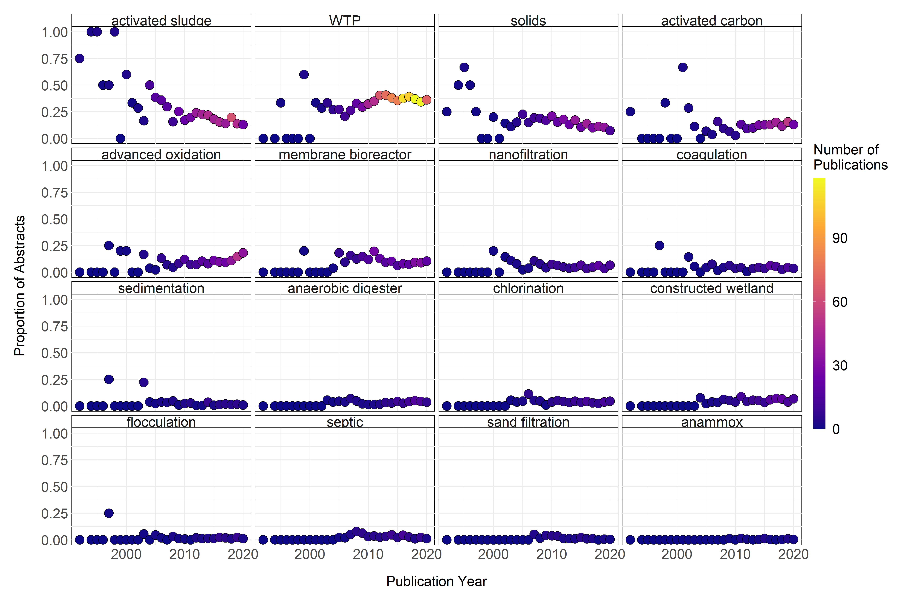
Most studied Sewage Treatment Techniques?

Slide 12
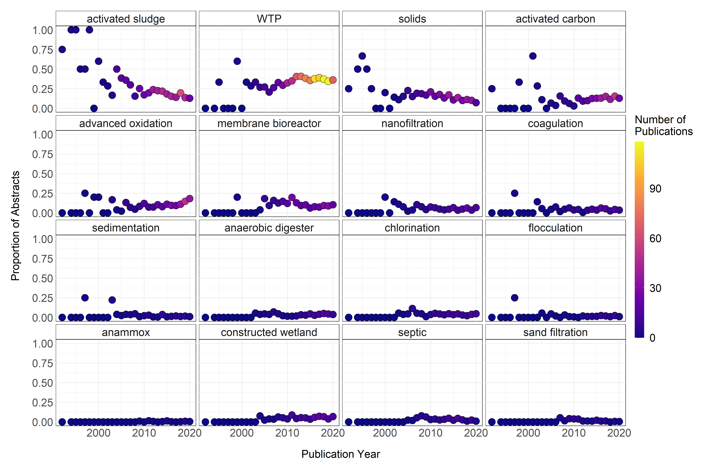
Less well studied Sewage Treatment Techniques?

Slide 13
Least studied Sewage Treatment Techniques?

Slide 14
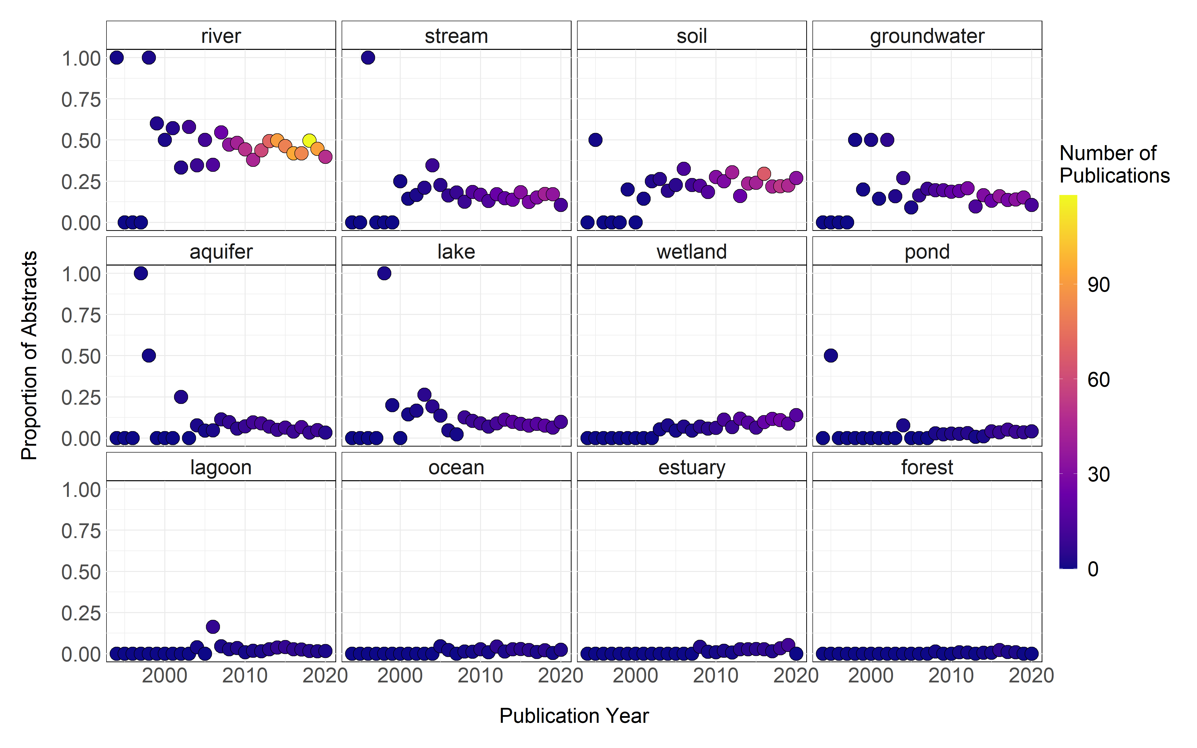
Most studied ecosystem types?

Slide 15
Less well studied ecosystem types?

Slide 16
Least studied ecosystem types?

Slide 17
But are we seeing the whole picture?
Hormones
Prescription Drugs
Septic Tanks
Groundwater
Fragrances
WWTP
Lakes
Antibiotics
Rivers
Solids waste
Terrestrial
Non-prescription drugs
Oceans & Estuaries

Slide 18
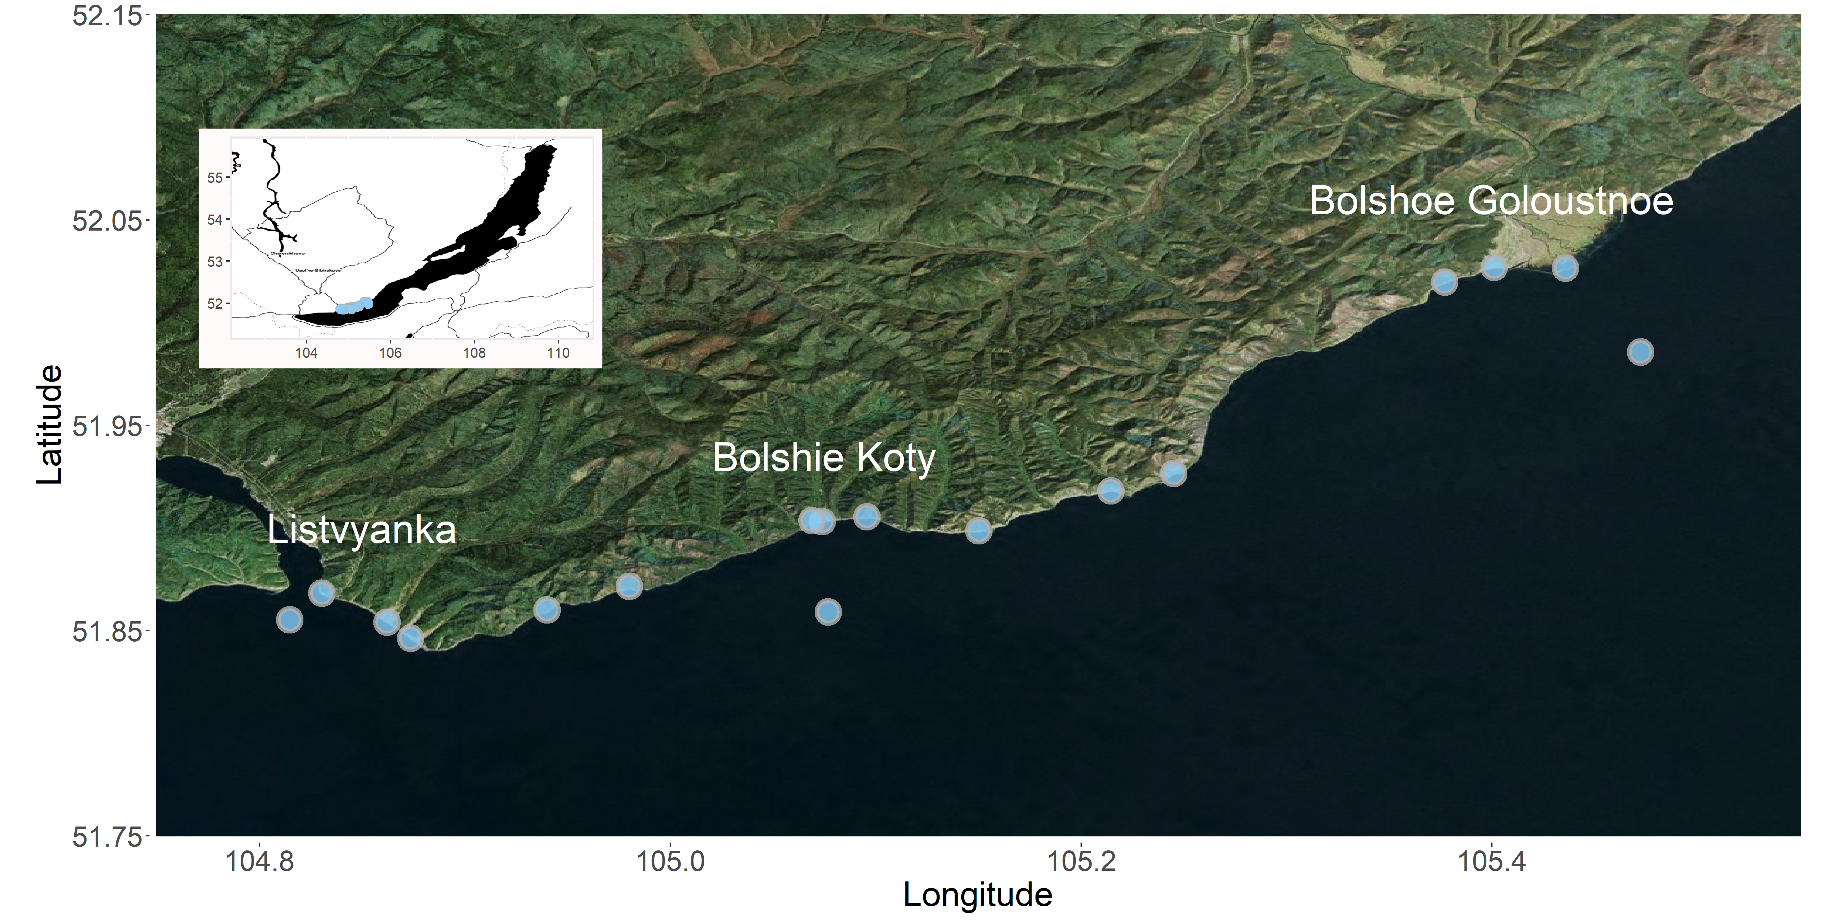
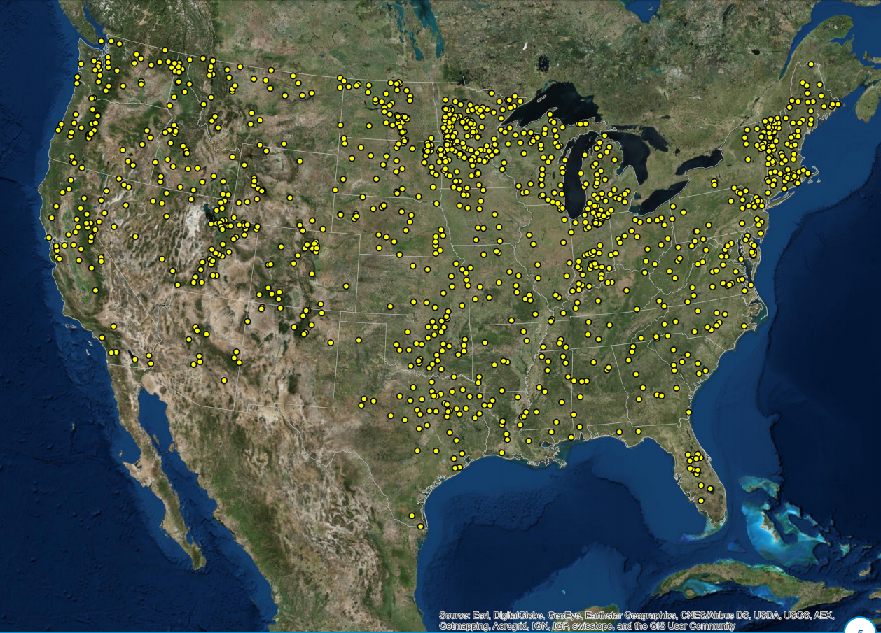
Intensively within systems & Extensively across systems

Slide 19
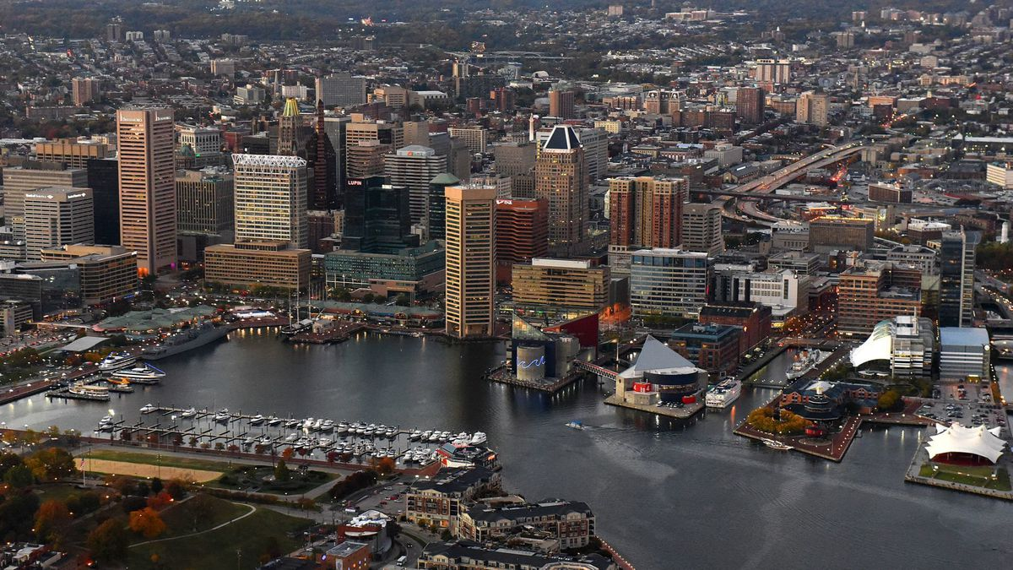
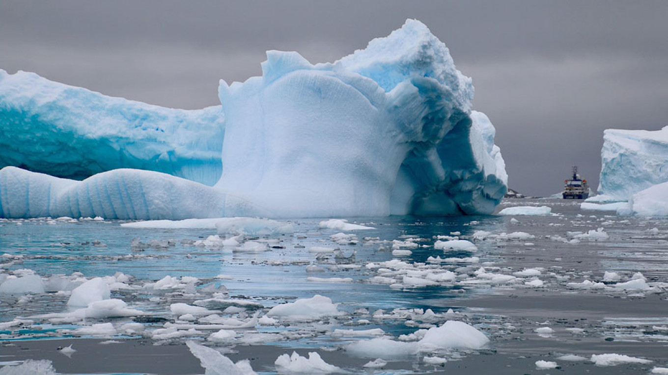
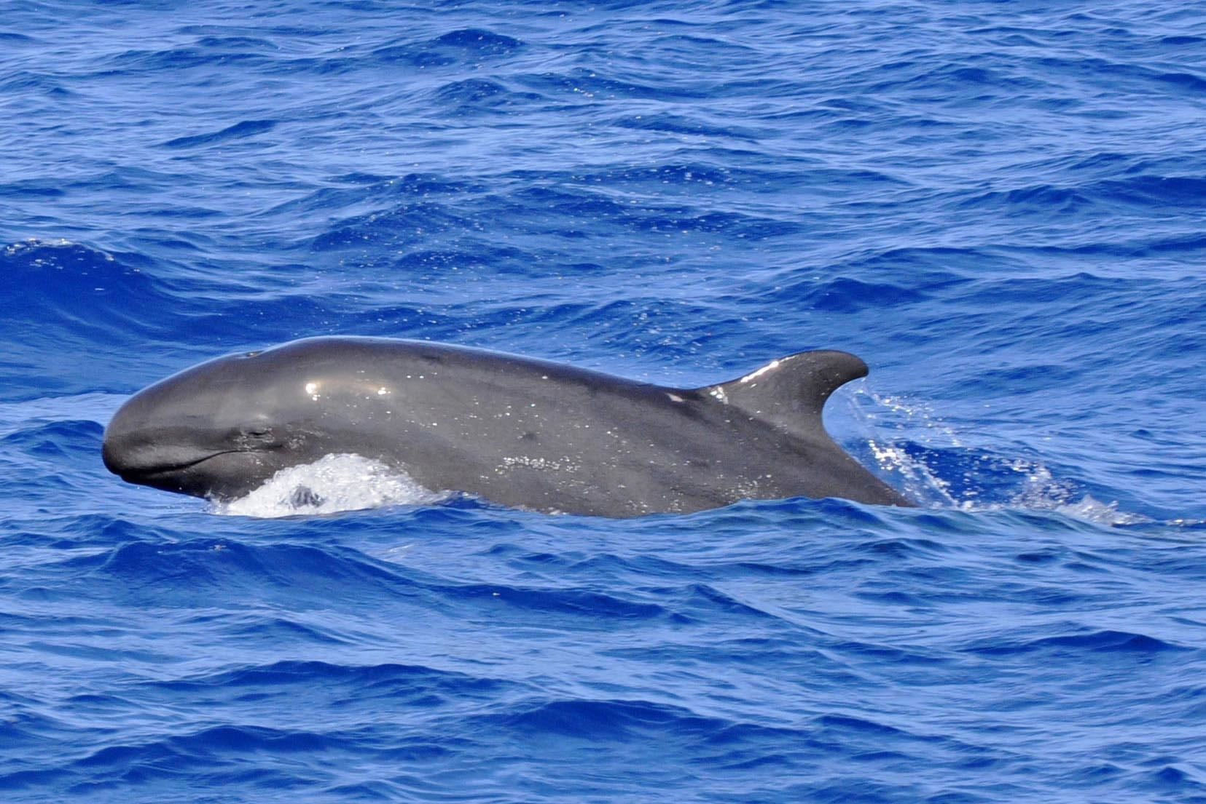
Intensification, Accumulation, and Legacy of PPCPS
https://www.baltimoresun.com/maryland/baltimore-city/bs-bz-state-of-downtown-20190325-story.html
https://www.themoscowtimes.com/2019/11/20/ice-between-russia-and-alaska-is-at-record-lows-scientists-warn-a68239
https://uk.whales.org/whales-dolphins/species-guide/false-killer-whale/

Slide 20
Thank You!
For updated #rstats code,
check out my GitHub!
michael.f.meyer@wsu.edu
@mishafredmeyer
@st3powers
@se_hampton

